Slide 1
Content rating system
Submitted by:
Haneena sayed muhammed

Slide 2
Contents
Abstract
Modules
Familiarization with build tools
NETBEANS
GIT hub
Bugzilla
EXISTING SYSTEM
PROPOSED SYSTEM
Table Design
UML DIAGRAMS
Forms

Slide 3
abstract
Content rating system is meant for the ordinary users to rate the videos and contents posted by different persons.
User can search different category wise videos, photos and contents to read and gain information about various subjects and thereby user can increase their knowledge.
Another main feature of this project is to post advertisements of their content and there by users can earn money.

Slide 4
Module description
1. ADMIN: Admin manages site and has the full power to add or remove the user.
Manage posted content
View comments
View ratings
Manage Category
2. ADVERTISEMENT AGENCY:
View posted contents
Rate posted contents
Post advertisement for cash
View ratings

Slide 5
3. USER:
Post videos
Post photos
Post Articles
View posted contents
Rate posted contents
Post complaints/feedback

Slide 6
Familiarization with build tools
The building tools are :
Net beans
GIT hub
The JAVA community is provided a few option including NetBeans and the long time font runner the eclipse IDE. The eclipse has lost some of its market share over the years to intel.

Slide 7
1. NetBeans
NetBeans is just an IDE.
They are entire platform net beans describe itself as an IDE that lets you quickly and easily develop java desktop, mobile and web application as well as HTML5 application with HTML.
It’s a great tool for large scale projects and makes it easier to bring on new developer because its structure is visible.
Net beans is module driven-everything in net beans happen via modules, which power and extends all its functionalities.
They are reusable.
It is excellent for converting to JAVA8.

Slide 8
2. Git hub
GIT is a version control system (Version control is a system that manages changes to a file or files).
Git is a VCS developed by Linux.
Its originally designed to help manage the LINUX kernel and make collaboration easy from the beginning.
GitHub is the most easy way to share project with collaborators.
This is extremely useful, especially when working in teams .

Slide 9
BUGZILLA
Bugzilla is an open-source issue/bug tracking system that allows developers effectively to keep track of outstanding problems with their product.
It is written in Perl and uses MYSQL database.
Bugzilla is a defect tracking tool, however it can be used as a test management tool as such it can be easily linked with other test case management tools like quality center, test link etc.
This open bug-tracker enables users to stay connected with their clients or employees, to communicate about problems effectively throughout the data-management chain.

Slide 10
Key features of Bugzilla includes:
Advanced search capabilities
E-mail notifications
Modify/file bugs by e-mail
Time tracking
Strong security
Customization
Localization

Slide 11
Existing System
The traditional content rating system was not fast.
Accuracy is less.
The system lacks integrity and security.
Highly time consuming.
Data redundancy and inconsistency.
Involves a lot of human efforts.

Slide 12
Proposed System
User can search different category wise videos, photos and contents to read and gain information about various subjects and thereby user can increase his knowledge.
It increases the counting speed.
It reduces human effort.
There is no chance of human errors.
It saves lot of time.
Result will be announced within a short period of time.
Provides much secure transactions.

Slide 13
TABLES
1 .tbl_login
Primary key: Id
Column Name | Data Type | Allow Nulls | Descriptions
Id | Int | No | Id
Username | Int | No | User name
Password | Varchar(50) | No | Password
Balance | Int | No | Balance Amount

Slide 14
2 . tbl_Channelreg
Primary key: chid
Column Name | Data Type | Descriptions
chid | Int | User id
chname | Varchar(50) | First name
ownername | Varchar(50) | Owner Name
Accno | Int | Account number
Email | Varchar(50) | E-mail address
Password | Varchar(50) | Password
Balance | Varchar(50) | Account balance

Slide 15
3 . tbl_cato
Primary key: cid
Column Name | Data Type | Descriptions
cid | Int | cotogory id
name | Varchar(50) | Category name

Slide 16
4 . tbl_ratE
Primary key: cid
Column Name | Data Type | Descriptions
video1 | Varchar(50) | id
rate | Double | user name
type | Varchar(50) | File name

Slide 17
5 . tbl_feed
Primary key: Cid
Column Name | Data Type | Descriptions
Cid | Int | Id
Subject | Varchar(50) | Subject
Content | Varchar(50) | Content
Userid | Varchar(50) | Userid
Reply | Varchar(50) | Reply
Status | Varchar(50) | Status

Slide 18
6 .tbl_content
Primary key: Id
Column Name | Data Type | Descriptions
Cnt_d | Int | Content Id
User_id | Varchar(50) | User id
pdate | Varchar(50) | Post date
cato | Varchar(50) | Category
video | Varchar(50) | Video file
picture | Varchar(50) | Image file
pdfs | Varchar(50) | Pdf file
vidrate | Double | rate

Slide 19
7. tbl_adpost
Primary key: Agid
Column Name | Data Type | Descriptions
Adid | Int | Agency id
adgid | Varchar(50) | Agency name
userid | Varchar(50) | User Id
adimg | Varchar(50) | Post name
pdate | Varchar(50) | Post date

Slide 20
8. tbl_adagency:
Primary key: Id
Column Name | Data Type | Descriptions
adagid | Int | Id
name | Varchar(50) | Agency name
regid | Int | Registration id
Accno | Int | Account number
ownername | Varchar(50) | Owner name
bankname | Varchar(50) | Bank name
address | Varchar(50) | address
Password | Varchar(50) | password
email | Varchar(50) | email
phno | Varchar(50) | Phone number
balance | Int | Balance amount

Slide 21
9 . tbl_booking
Primary key: Id
Column Name | Data Type | Descriptions
Id | Int | Transaction id
adagid | Int | From user
userid | Int | To user
date | Varchar(50) | Phone number
status | Int | Account number

Slide 22
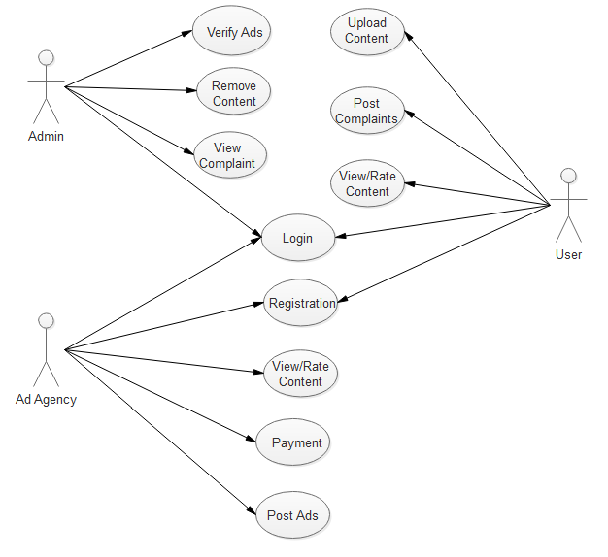
Use case diagram

Slide 23
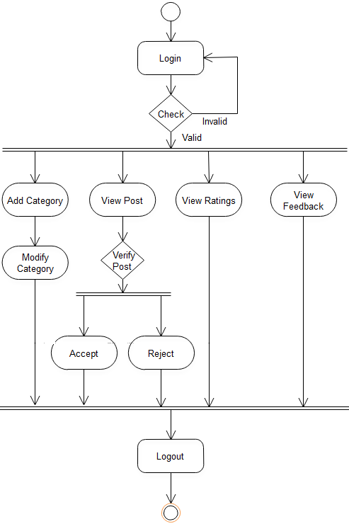
Activity diagram
ADMIN

Slide 24
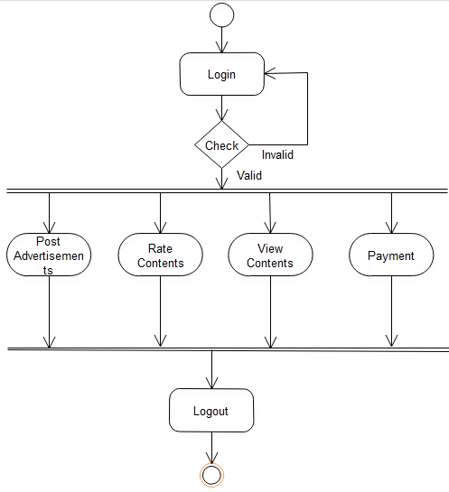
ADVERTISEMENT AGENCY

Slide 25
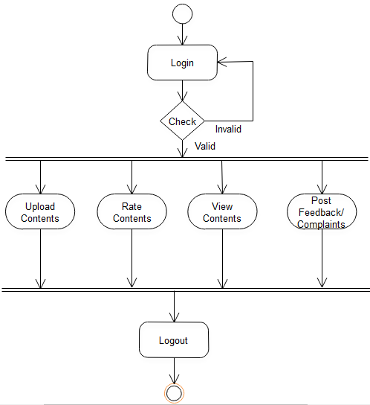
User

Slide 26
FORMS

Slide 27
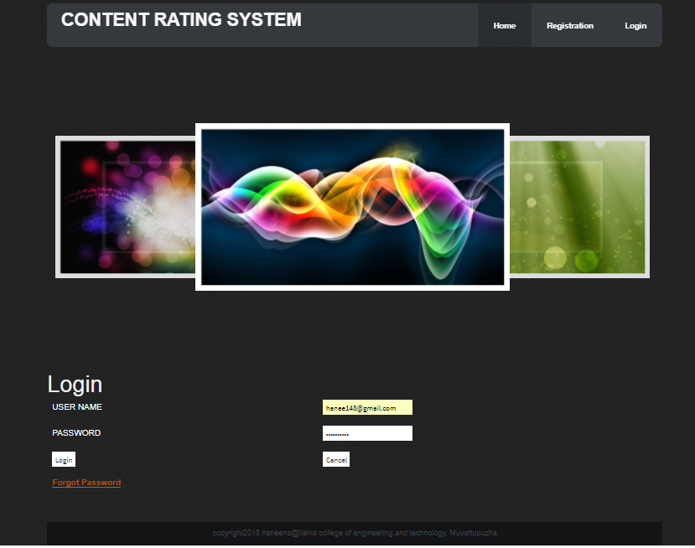
Login Page

Slide 28
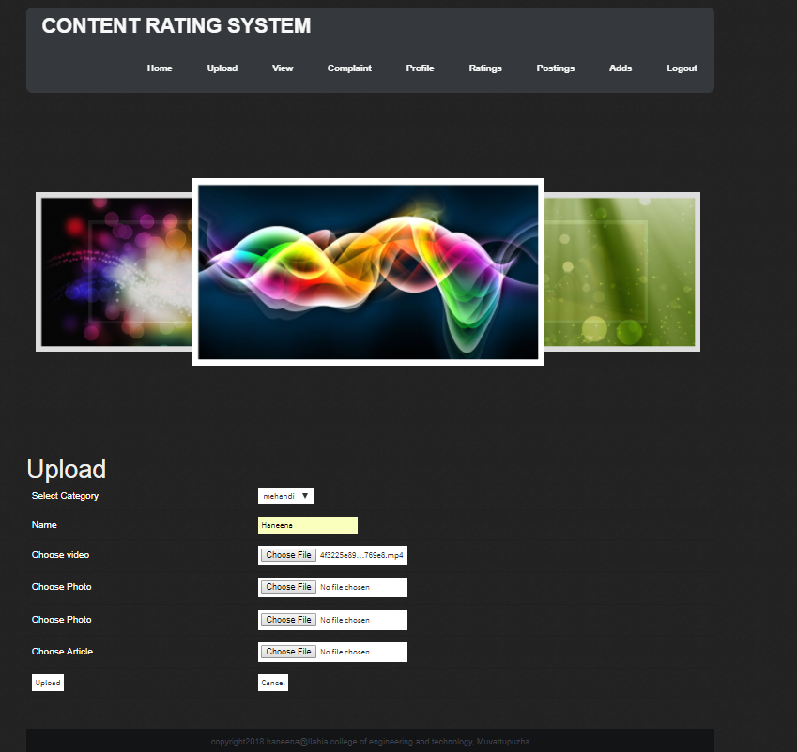
User PAGE

Slide 29
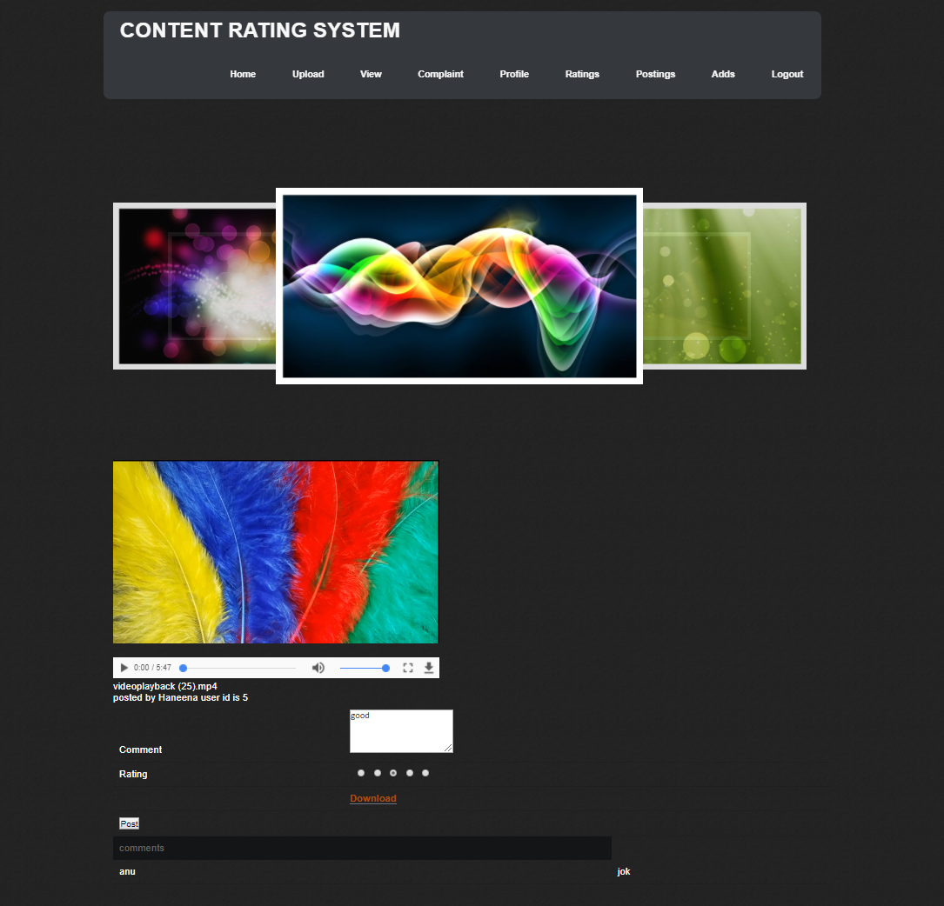
Post comments and rating the contents

Slide 30
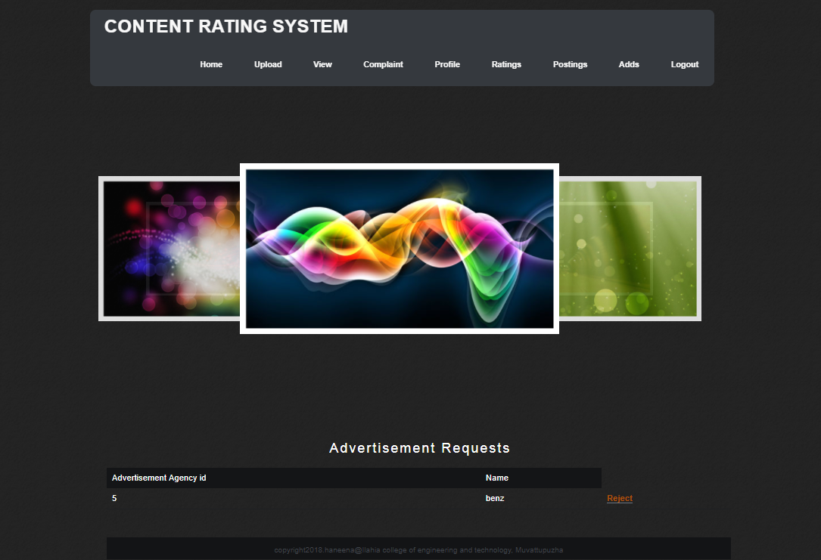
Request FROM THE ADVERTISEMENT AGENCY

Slide 31
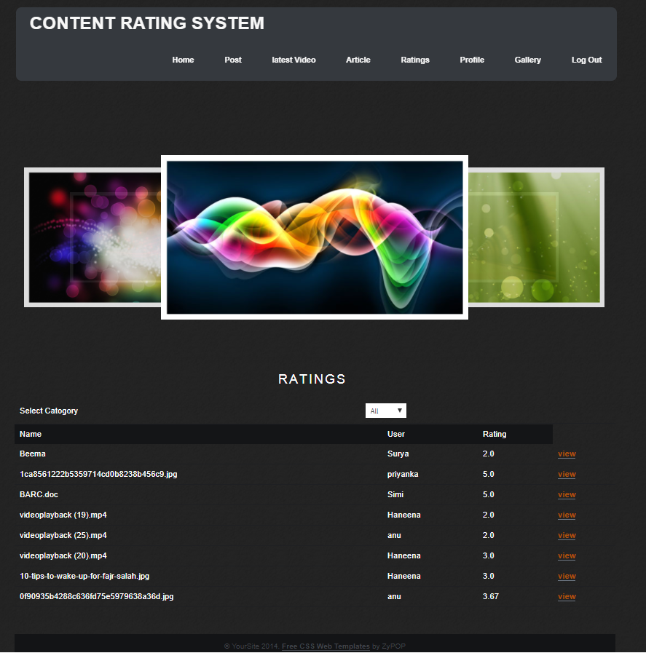
VIEW RATINGS

Slide 32
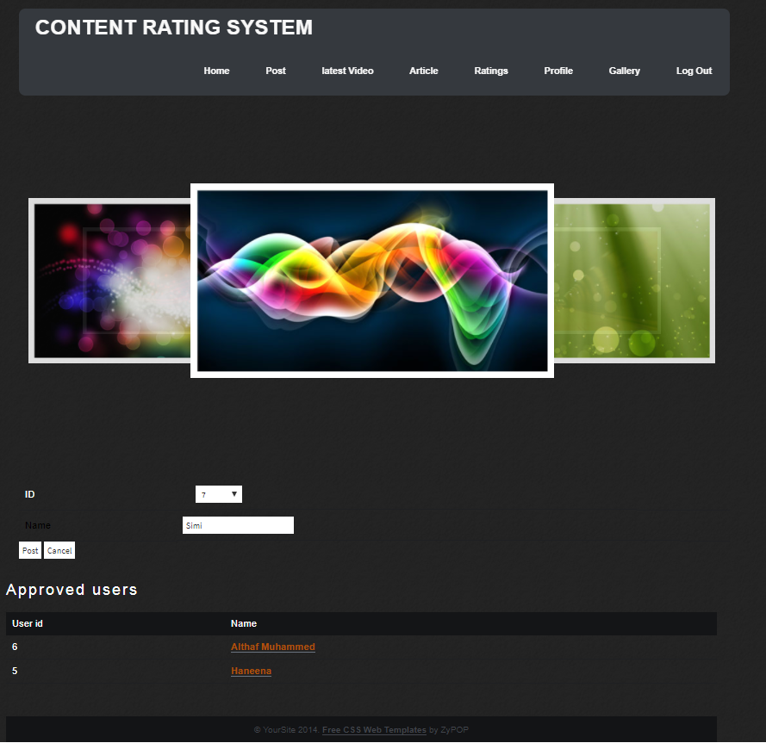
ADVERTISEMENT AGENCY

Slide 33
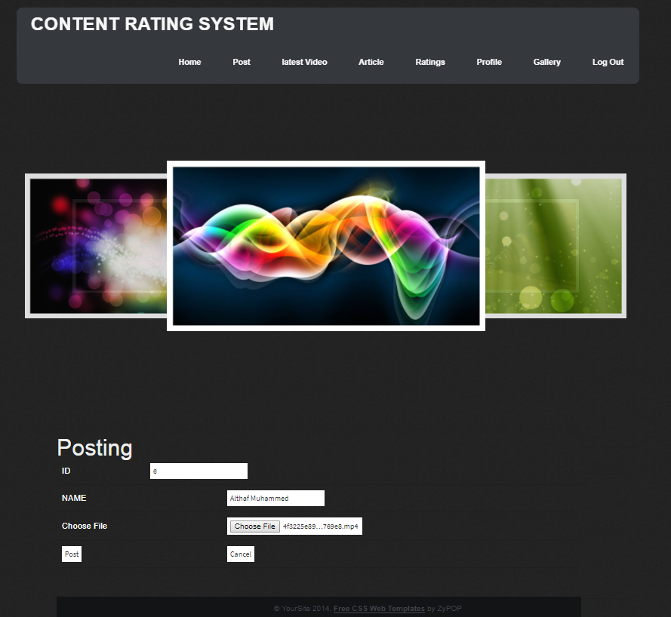
POST ADVERTISEMENT

Slide 34
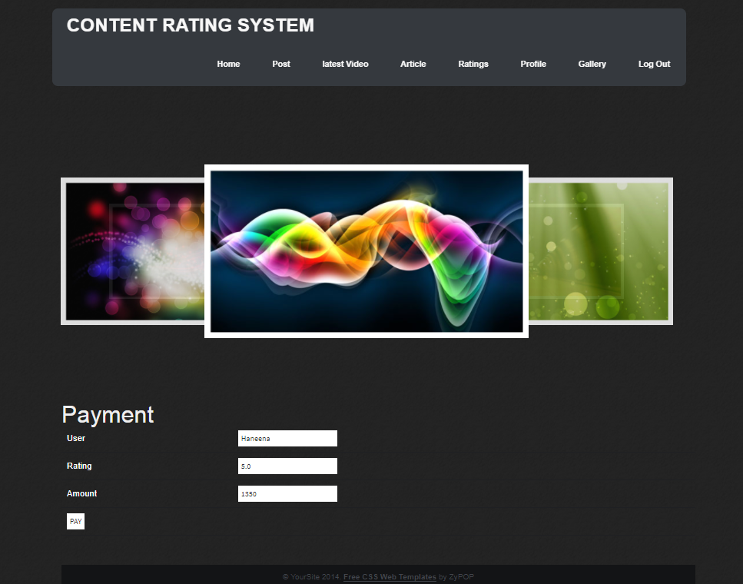
PAYMENT FOR USERS

Slide 35
VIEW RATINGS

Slide 36
Post comments and rating the contents

Slide 37
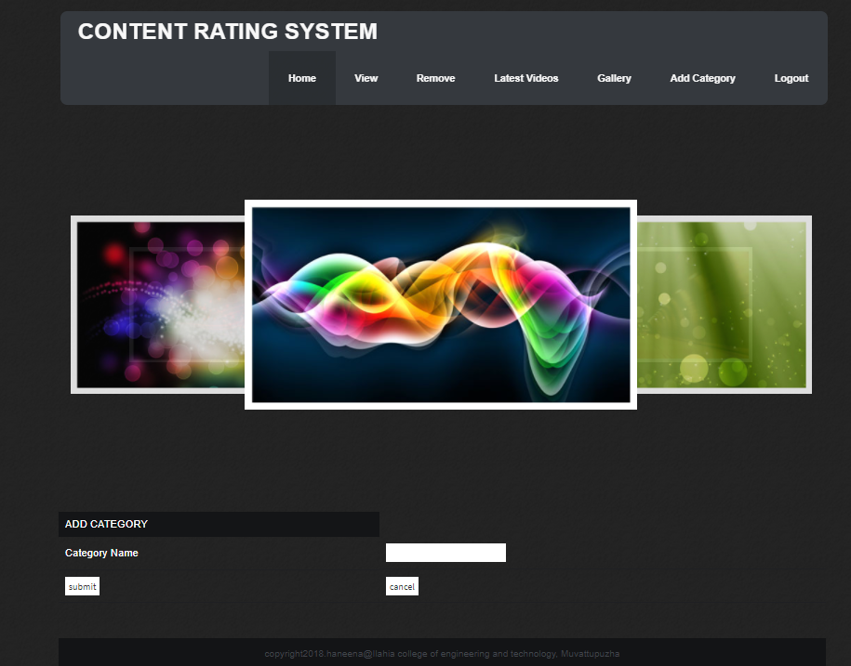
Admin

Slide 38
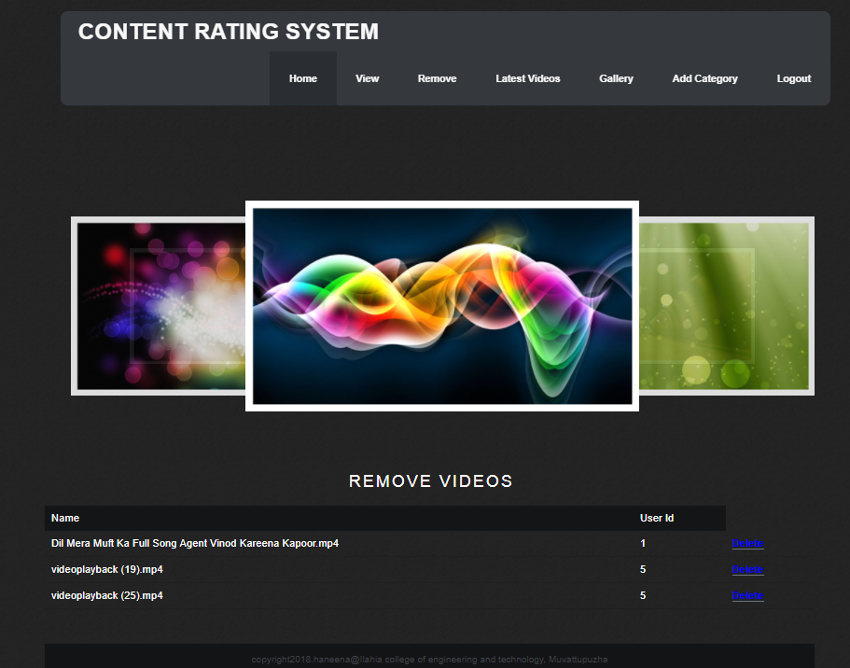
REMOVE VIDEOS

Slide 39
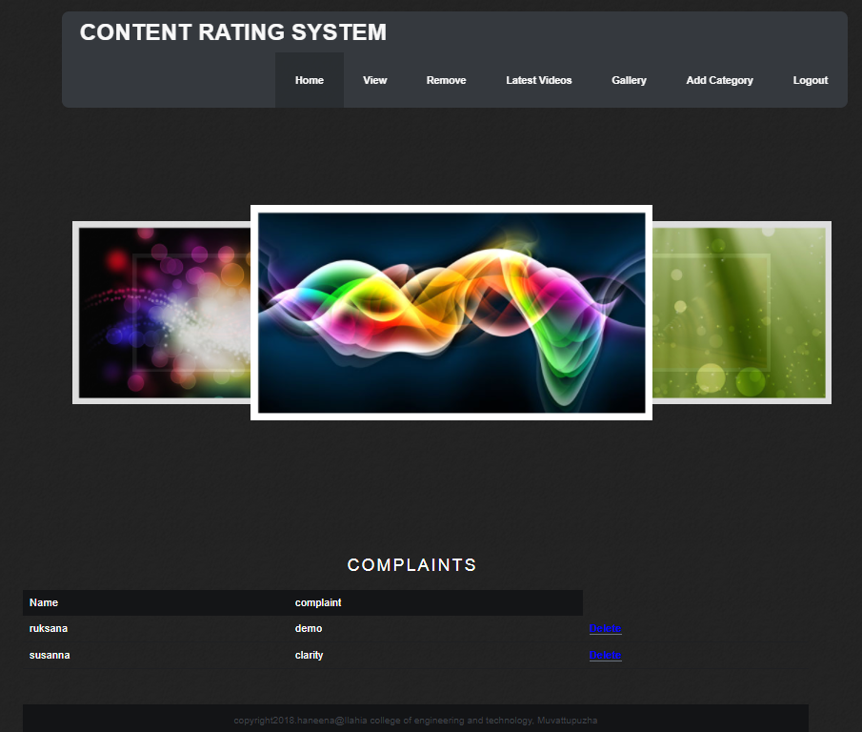
VIEW COMPLAINTS

Slide 40
THANK YOU

